Slide 1
Command Analytics SAP BusinessObjects Web Intelligence Author Course
Command Analytics SAP BusinessObjects Web Intelligence Author Course
October 2018
Cameron Carswell, Daniel Piché, Sabuj Haque
.

Slide 2
Onboarding
Onboarding is done for consumers and authors when they get their BI Account:
Onboarding Handout
Plug in PKI card and connect to Cisco AnyConnect VPN
BI Portal (MOP 350) (one time log-in): http://m6bci.forces.mil.ca:59000/irj/portal
Federated Portal (MEP 700)*: http://mp9ci.forces.mil.ca:58800/irj/portal
Command Analytics Support Centre Portal
ADM (Data, Innovation and Analytics)
DLN Learning Portal
Secure Global Desktop
Command Analytics Authors:
Reporting Design and Standards Guide
Analytics Author Communiqués
Strong Secure Engaged

Slide 3
Getting Started
Instructor Introduction
Students Introduction (Name, L1, Attendance Purpose)
Class hour and break schedule
Exercise 26: Create your own Web Intelligence Document

Slide 4
Chapter 1 – Introduction
1.1. Web Intelligence (WebI)
1.2. KPQ, KPI and CSF
1.3. WebI Architecture
1.4. Accessing WebI
1.5. WebI Document
1.6. WebI Data Sources
1.7. WebI Author’s core functionalities

Slide 5
Introduction
Welcome to the Command Analytics SAP BusinessObjects Web Intelligence Author Course.
During this course you will use your own account to learn how to generate Web Intelligence Documents both from a new document and from a template.
You will learn to pull data from DRMIS data warehouse (called DRMIS Business Warehouse (BW)) as well as Microsoft Excel SpreadSheets.
You will be able to create reports with interactive input controls, which allow consumers to filter the information that they want to see.
All the content and exercises during this course are yours to keep.
Ch. 1

Slide 6
Web Intelligence (WebI)
Web Intelligence (WebI) is a web based ad hoc reporting and analysis tool in the SAP BusinessObjects (BOBJ) platform that enables governed agile self-service analytics.
SAP BOBJ is a suite of front-end applications for SAP Business Intelligence (BI). SAP BI is comprised of a set of processes driven analytical tools and WebI is one of those tools.
WebI helps command to make effective decisions quickly. It also allows those who own the business to efficiently examine and create reports to support evidence based decision-making.
WebI is used to query the data warehouse, to make report, to carry out analysis, to share key data, and to make appropriate command decisions. It also allows users to access and analyze data from various online and offline sources.
Ch. 1

Slide 7
KPQ, KPI and CSF
Analytics is the discovery, interpretation, and communication of meaningful patterns of data. Command Analytics is the process of using data to inform key command decisions.
Key Performance Question (KPQ), Key Performance Indicator (KPI) and Critical Success Factor (CSF) are important elements to Command Analytics.
KPIs are the data that are essential in answering the KPQs. Reports must provide graphical representation of the KPIs in order to answer the questions.
However, unless there is a clear understanding of the desired outcomes of the KPQs, the KPIs will not answer the KPQs.
Certain elements of data can be identified as CSFs, and reports with action plans can be created to address these elements.
Ch. 1

Slide 8
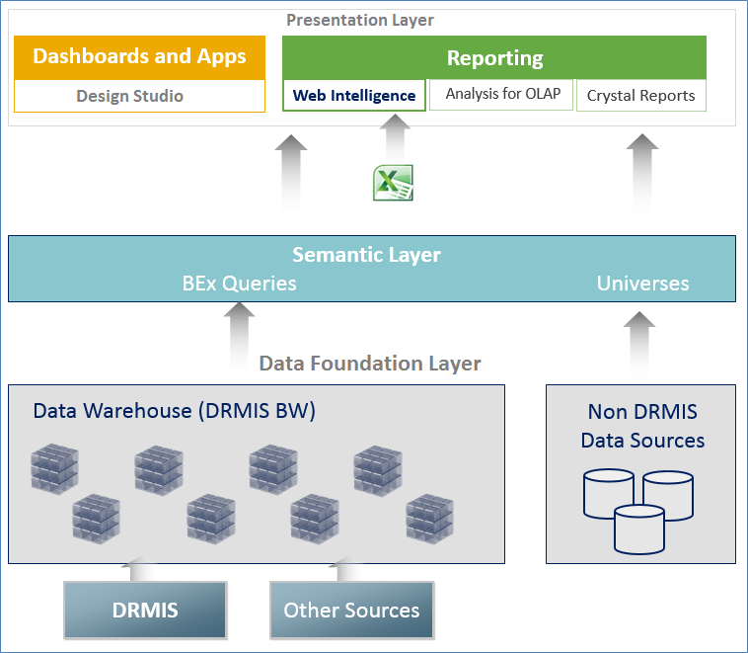
WebI Architecture
WebI has three-tier architecture:
Data Foundation Layer
Semantic Layer
Presentation Layer
Ch. 1
Notes:
Data Foundation Layer
Data foundation layer extracts and merges transactional and historical data from SAP and non-SAP source systems when executing queries.
Semantic Layer
Semantic layer exposes data from the Data Foundation Layer to Presentation Layer Subject-Area oriented repositories (Data Sets) designed to facilitate Querying and Reporting Business-Friendly Characteristics and Measures.
WebI Author uses semantic layer to create reports and analyze information, and then share it with other online or offline users. The semantic layer is everyday business vocabulary of an organization’s data without technical complexities. The semantic layer is presented by one or more Universes and/or BEx queries.
Presentation Layer
Presentation layer offers flexible set of tools, like, WebI, Design Studio, Analysis of OLAP, Crystal Report, etc., for the end users to access, visualize and analyze data.

Slide 9
WebI Architecture (contd.)
Data Foundation Layer
Data foundation layer extracts and merges transactional and historical data from SAP and non-SAP source systems when executing queries.
Semantic Layer
Semantic layer exposes data from the Data Foundation Layer to Presentation Layer Subject-Area oriented repositories (Data Sets) designed to facilitate Querying and Reporting Business-Friendly Characteristics and Measures.
WebI Author uses semantic layer to create reports and analyze information, and then share it with other online or offline users. The semantic layer is everyday business vocabulary of an organization’s data without technical complexities. The semantic layer is presented by one or more BEx queries and/or Universes.
Presentation Layer
Presentation layer offers flexible set of tools, like, WebI, Design Studio, Analysis of OLAP, Crystal Report, etc., for the end users to access, visualize and analyze data.
Ch. 1

Slide 10
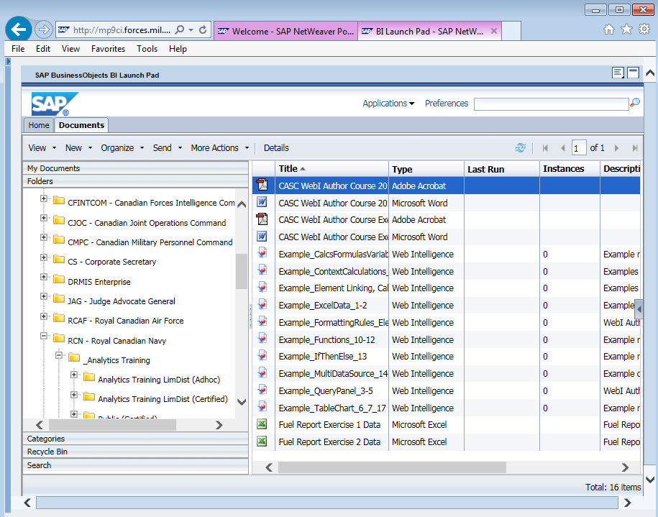
Accessing WebI
A WebI user (Author/Consumer) uses an Internet browser to log onto the BI Portal, called SAP BusinessObjects BI Launch Pad, and then view a WebI document to analyze data.
The BI Launch Pad also stores Dashboards, Crystal Reports, Analysis Workspaces, Excel SpreadSheets,
Adobe PDFs, etc.
Ch. 1

Slide 11
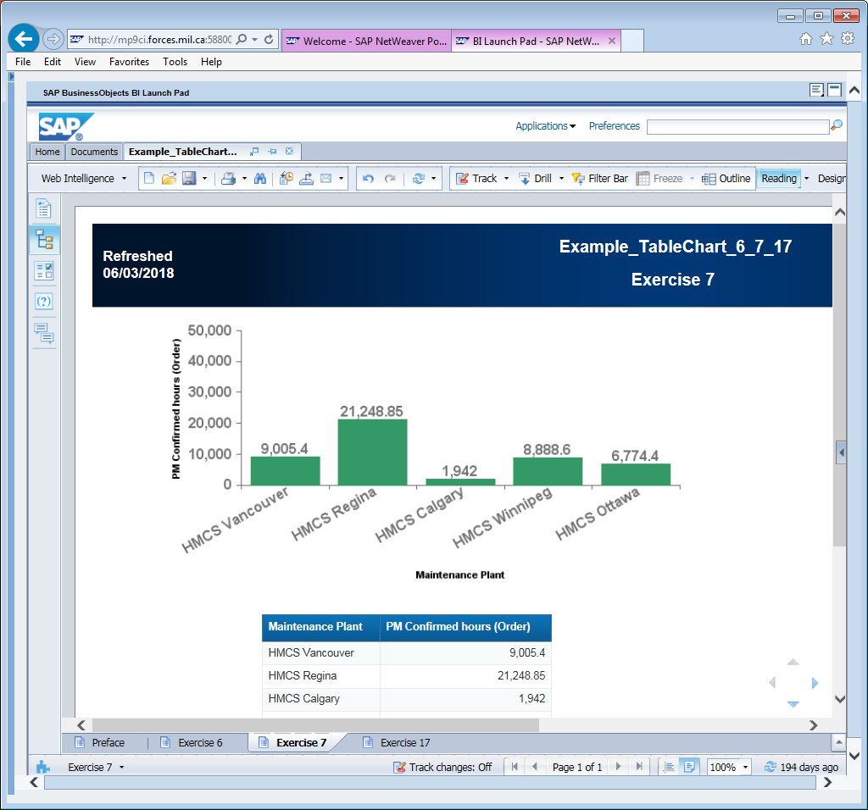
WebI Document
A WebI Document is comprised of one or more reports organized as tab pages along the bottom of the window.
Each Reports may contain one or more blocks of formatted texts, tables and charts.
Ch. 1

Slide 12
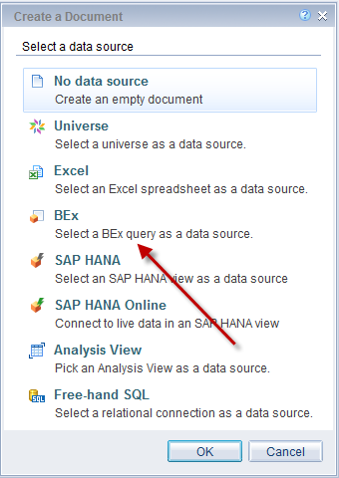
WebI Data Sources
WebI allows users to create reports based on BEx Queries, Universes and Excel SpreadSheets. WebI can access data from various sources:
Relational database via Universe
Online Analytical Processing (OLAP) server
Excel SpreadSheet
Business Explorer (BEx) query
Analysis View
SAP HANA and SAP HANA Online
Free-hand SQL on a relational connection
Ch. 1

Slide 13
WebI Author’s core functionalities
A WebI Author has four core functionalities:
Querying - creating query(s) in WebI Query Panel
Reporting - creating WebI Report(s) in WebI Report Panel
Analyzing - analyze WebI Report(s)
Sharing - sharing WebI Report(s)
Ch. 1

Slide 14
WebI Author’s core functionalities (contd.)
1. Querying:
A WebI Author uses the Query Panel to add a Query on a selected source (like, a BEx query or an Excel SpreadSheet) and then add objects (dimensions and measures) from the Query into the Results Objects section. For most sources, query filters can also be used to restrict the data being fetched from the database.
When executed, the query is being converted into equivalent SQL statement and this statement is then being sent to the WebI Server for processing. WebI Server sends the SQL statement to database to retrieve data correspond to the selected objects. The rows of data returned by the database are stored in microcube in WebI Server, called a Data Provider.
A WebI document can contain multiple queries which are being fed to the corresponding Data Providers.
Ch. 1

Slide 15
WebI Author’s core functionalities (contd.)
2. Reporting
The WebI Author then creates one or more reports in WebI Report Panel by dragging and dropping objects from these Data Providers into various design components, like, charts, tables, etc. He/she also formats and organizes the data, highlights important ones, creates formulas and variables, adds multidimensional analysis techniques, like, drill-down or drill-through capabilities, etc.
3. Analyzing
The WebI Author uses the WebI reports to analyze various ad-hoc questions and/or to create analytic reporting for his/her department and/or organization.
Ch. 1

Slide 16
WebI Author’s core functionalities (contd.)
4. Sharing:
The WebI Documents are stored centrally in the BI server for everybody in the organization to access them as per their authorization level.
A WebI Document can be scheduled to run on a periodic basis so that one could access up to date data without waiting for the report to execute lengthy database queries.
The WebI document can also be disseminated to online or offline (i.e. users without BI account) users via e-mail as either WebI Document, Adobe PDF, Excel SpreadSheet, Comma-Separated Value (.CSV) or Plain Text.
Ch. 1

Slide 17
Chapter 2 - DRMIS System Landscape
2.1. DRMIS Environment
2.2. Types of BOBJ BI Accounts
2.3. Signing into BI Portal
2.4. Setting Java preferences
2.5. Setting WebI preferences
2.6. Folder Structure
2.7. Course Documents

Slide 18
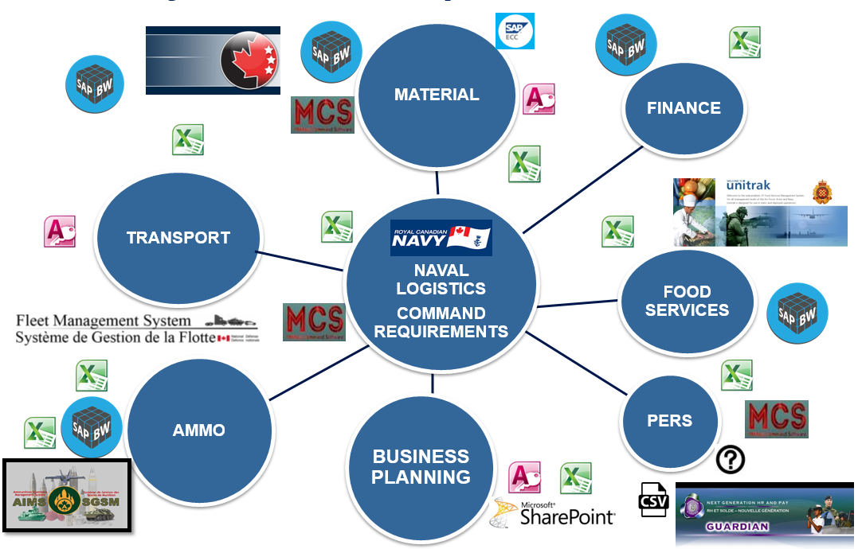
DRMIS System Landscape - RCN
There are many parts to the DND information management and analytical toolset as shown in the above diagram.
Ch. 2

Slide 19
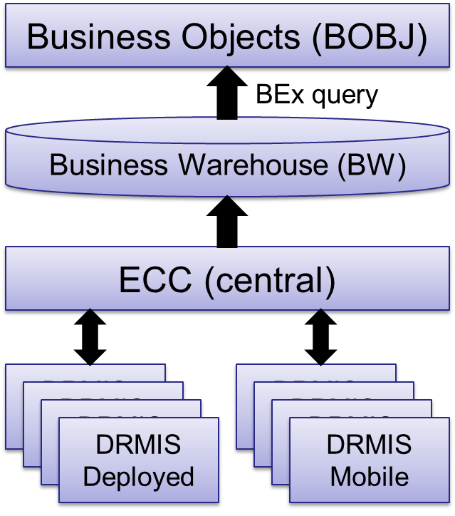
DRMIS Environment
The DRMIS enclave is accessed through the Virtual Private Network (VPN). This is accessed through a Public Key Infrastructure (PKI) authentication.
SAP’s various ECC (ERP Central Component) modules form the central DRMIS ECC Production instance.
Additionally, each ship has a Deployed DRMIS server and each submarine has a Mobile DRMIS server.
The DRMIS Business Warehouse (BW) is a data warehouse that stores current and historical data from DRMIS.
DRMIS ECC data is uploaded to DRMIS BW at various intervals, some are either daily or weekly or monthly (as per business/technical requirements).
BOBJ tools, like, WebI, Crystal Report, Dashboard, etc., uses Business Explorer (BEx) queries to access DRMIS BW data.
Ch. 2

Slide 20
Types of BOBJ BI Accounts
There are different types of BOBJ BI accounts in DRMIS:
Authors are able to create reports, run BEx Queries, and manipulate reports fully. This is the type of access you will have when performing this WebI course.
Consumers are able to view reports and make basic manipulations of the report. This is the most common account and most users fall under this access.
Delegated Administrators are able to maintain various system and/or user aspects in BI Launch Pad.
Publishers are able to schedule reports to be updated at scheduled times, as well as produce PDF reports for distribution.
Ch. 2

Slide 21
Signing into BI Portal
To access WebI and create reports, one needs to access the BI Portal, called SAP BOBJ BI Launch Pad.
However, in order to connect to the BI Portal, one needs to connect to the Virtual Private Network (VPN) using DWAN credentials first. While connecting to the VPN, a prompt for the Public Key Infrastructure (PKI) will occur. A PKI card, login and password must be provided.
After that browse to DRMIS Portal Application webpage to access the BI Portal using your DRMIS BI user ID and password.
Ch. 2

Slide 22
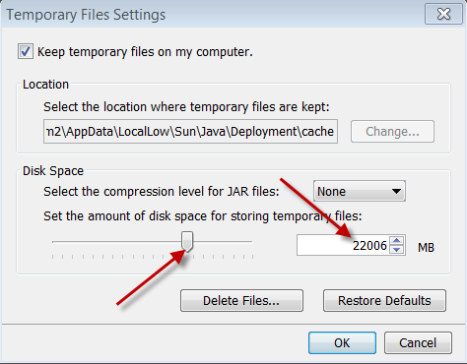
Setting Java preferences
To ensure that WebI document opens and loads quicker in Java Applet mode, one needs to enable the “Keep temporary files on my computer” option in Java in Windows’ Control Panel.
These steps will need to be carried out on user’s personal workstation and as well as any other PC that he/she may be using to display WebI Reports, like, conference room or board room PCs, etc.
The end of course wrap-up email will remind you to do so on your own computers.
Ch. 2

Slide 23
Setting WebI preferences
Start-up Folder:
Under the “Preferences” -> “General” section, the user needs to set the start-up folder (under Documents tab -> Folders) to be whatever folder he/she would be working more frequently. For this course please set it to the training folder (follow along with instructor).
WebI Settings:
Under the “Web Intelligence” section, following preferences should be set:
View in HTML mode
Modify in Applet mode
These settings are BI userid specific and hence the user only have to make these changes once.
Ch. 2

Slide 24
Folder Structure
On BI Launch Pad, various folders have been created to serve various L1s and their Line of Businesses (LOB).
Folders are further sub-divided into folders labeled as “Adhoc” and “Certified.”
Adhoc report folders will hold all works in progress, which may be accurate, up to date, and relevant but may not have necessarily been certified and published.
Certified reports have been approved by the Business Owner and the Solution Owner and have gone through the CASC Certification process. They are ready to be used for reporting within that LOB.
The Command Analytics Document Certification process needs to be used to get any Adhoc report certified.
Ch. 2

Slide 25
Course Documents
This course has a set of pre-made examples and templates to help users in learning the WebI.
Users can find them within the folders tab under the following folder:
Public Folders \ RCN – Royal Canadian Navy \ _Analytics Training \ RCN LimDist (Adhoc) \ Web Intelligence \ Current Courses \ Students \ All Students
Ch. 2
Notes:
Copy the folder “All Students” and rename it to your CA username in the same folder in upper case. You can use this folder for this course.
You can also copy this folder into your “My Favorites” folder under “My Documents.”
Within that folder you will find a “RCN – Template - Empty” document.
You can also find updated Navy Favorite Templates under the “RCN – Royal Canadian Navy” folder, and “_Templates and Resources.”
As new editions of the Navy template get created, they will be posted in this folder.

Slide 26
Chapter 3 – Basic WebI Operations
3.1. Opening a WebI Document
3.2. WebI Application Modes
3.3. WebI Viewing Modes
3.4. WebI Application Structure
3.5. Saving a WebI Document
3.6. Cut, Copy or Delete a WebI Document
3.7. Document Properties
3.8. Uploading a document or an Excel spread sheet
3.9. Saving within the WebI Course Folder
3.10. Creating New WebI Document

Slide 27
Opening a WebI Document
A WebI Document can be opened in view mode or in modify mode.
Based on the preferences set for Web Intelligence in BI Launch Pad, view or modify window will open in either HTML, Applet or PDF mode.
You may access the following modes from the context menu of a WebI Document name:
View Mode (which by default opens in the Reading Mode)
Modify Mode (which by default opens in the Design Mode)
Ch. 3
Notes:
View or Reading Mode
Right click on the name any WebI Document to get the Context Menu and click on “View” to open the document in Reading mode.
In the reading mode you would be able to do following:
Create, open, save, print and search document
Refresh a document’s query(s)
Use the Track, Drill, Filter Bar and Outline options
Export data to PDF, CSV, Excel and Text format
Based on the Preferences set for Web Intelligence in BI Launch Pad, this will either open in HTML, Applet or PDF mode.
Modify or Design Mode
Right click on the name any WebI Document to get the Context Menu and click on “Modify” to open the document in Design mode.
In the Design Mode, you would be able to do everything from the Reading mode plus all the formatting and analysis features, like, Report Element, Formatting, Data Access, Analysis and Page Setup.
Based on the Preferences set for Web Intelligence in BI Launch Pad, this will open in either HTML or Applet.

Slide 28
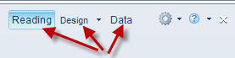
WebI Application Modes
In the Java Applet mode you will find three ways to interact with the document on the top right corner: Reading, Design and Data.
In the HTML mode there are only two modes: Reading and Design.
The Reading mode shows what consumers can see and how the report is presented. It has a smaller Top Menu and a limited left-hand menu, focusing on the Document Summary and Input Controls.
The Design mode allows the user to manipulate the report. It is available only to authors and publishers.
The Data mode (only available in Applet mode) shows what data providers, i.e., queries selected, for the reports.
Ch. 3
Notes:
Reading Mode
The reading mode shows what consumers can see and how the report is presented. It has a small Top Menu and a limited left-hand menu, focusing on the Document Summary and Input Controls.
Design Mode
The design mode allows the user to manipulate the report. It is available only to authors and publishers.
It has two view settings, “With Data” and “Structure Only.” The “Structure Only” view shows the tables and formulas, and the data script that populated them.
Data Mode
The Data mode (only available in Applet mode) shows what data providers, i.e., queries selected, for the reports.
In this mode you can create, edit, purse or refresh a data provider, merge objects from different sources, change an existing data source by replacing with another equivalent data source, and export data directly from the data provider into CSV file.

Slide 29

WebI Viewing Modes
In the Reading and Design modes, you can choose either Quick Display mode or Page mode.
These buttons are available at the right bottom area of the WebI screen on the status bar.
Ch. 3
Notes:
Page view mode
This mode display the page layout of the report using margins, headers and footers. All the formatting options are being utilized and displayed in this mode. In addition, what you see in this mode is what you can expect when you would print your report as PDF document or via a printer.
Quick Display view mode
This mode is based on data, rather than the physical size of report pages and all the formatting options.
For tables and sections, it displays maximum number of records vertically and horizontally, depending on the Quick Display settings. You can specify the minimum page width and height and the amount of padding around the edges of the report for the Quick Display mode.
This mode is used to focus on analyzing results, add calculations or formulas, or add breaks or sorts to tables to organize results.

Slide 30
WebI Application Structure
The mostly used Design mode has following areas:
File tab page
Properties tab page
Toolboxes
Side panel
Status bar
Tools
Ch. 3

Slide 31
Saving a WebI Document
WebI documents can be saved into two different locations:
The “My Favorites” folder allows the author to save a document that can only be accessed through his/her own BOBJ account.
The “Public Folders” include a file structure for each line of business and includes relevant sub-folders. An author can save reports under his/her LOB’s folder structure.
Ch. 3

Slide 32
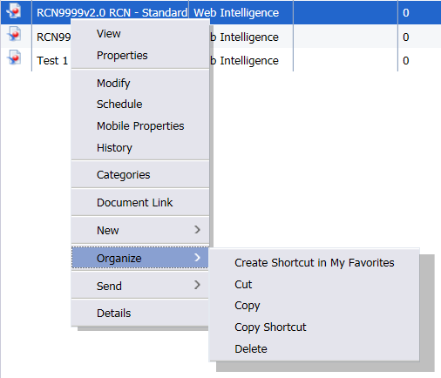
Cut, Copy or Delete a WebI Document
One can cut, copy or delete documents within the WebI folders.
To copy, cut, paste, or delete an item, right click on the document name and click on “Organize.”
Ch. 3

Slide 33
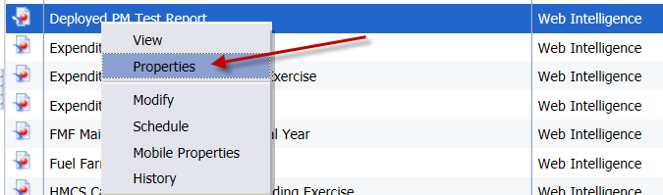
Document Properties
To set various document properties, right click on the document name and click on “Properties.”
Ch. 3

Slide 34
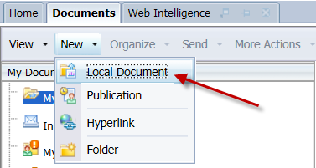
Uploading a document or an Excel spread sheet
Within the Documents tab and within the BOBJ file structure, you can add files to your favorites or to the public folders by selecting “New” and “Local Document.”
Ch. 3

Slide 35
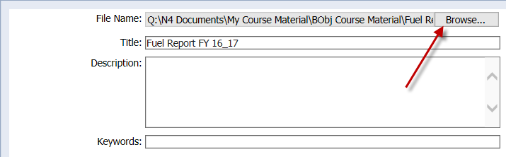
Uploading a document or an Excel spread sheet (contd.)
Then, click on the “Browse…” and insert the document that you wish. Generally, you will be inserting Excel SpreadSheets.
Every WebI or any other document on BI Launch Pad (like, Excel SpreadSheet, Adobe PDF, etc.) gets a unique ID called CUID.
Ch. 3

Slide 36
Saving within the WebI Course Folder
In this course you will be asked to create multiple Web Intelligence Documents (WID).
Save all documents to the following file structure within your folder that you named with your CA User ID (example: JSMITH).
Save your documents following the naming convention outlined in each exercise. For Example, “Exercise 1” requests that you save your document as your “(last name)_QueryPanel_1-4.”
Ch. 3

Slide 37
Creating New WebI Document
A new WebI Document can be created from the template or on a blank unformatted document.
It is recommended to use L1 specific Template, like the RCN Template (called “RCN9999v2.0 RCN - Standard Template – Empty”), located in the following folder whenever one needs to create a new WebI Document:
Public Folders \ RCN – Royal Canadian Navy \ _Templates and Resources \ Adhoc
Ch. 3

Slide 38
Bonus Chapter – CUID
What is CUID?
Why is it relevant?

Slide 39
What is CUID?
The CUID (Cluster Unique Identifier) is part of BOBJ metadata stored in the repository database which is used to connect all the BOBJ items, like, WebI Document, Universe, Excel file, etc.
It’s a 35 character long hexa-decimal string that looks like below:
M1ug.KQADUkCAPcAogAATVQKAgrX98YAAAA
Every file or document created on BI Launch Pad gets a unique CUID.
If you delete an existing excel spreadsheet from BI Launch Pad and reload it with the same name again in the same folder, the new file will have a different CUID than the previous file.

Slide 40


Why is it relevant?
Life-cycle of how to extract and upload an Excel file for WebI reports:
CSVFile1.txt
ExcelFile1.xls
Legacy Application / Database
CSV
2
1
Prepare the right layout/format for WebI
Extract Data from Legacy DB
User’s PC
3
Upload the Excel file on to the BI Launch Pad
BI Launch Pad
WebIDoc1
ExcelFile1.xls
4
Query 1: connected using CUID: XLS1
CUID: WebI1
CUID: XLS1

Slide 41
Why is it relevant? (contd.)
When we create a query in WebI based on an Excel spreadsheet, the Excel file is connected to the WebI via its unique CUID. You may even have multiple Excel files connected to one or more WebI documents based on each of those excel files’ CUID.
ExcelFile1.xls
WebIDoc1
Query 1: connected using CUID: XLS1
CUID: XLS1
CUID: WebI1
Query 2: connected using CUID: XLS2
ExcelFile2.xls
Query 3: connected using CUID : XLS3
CUID: XLS2
WebIDoc2
ExcelFile3.xls
Query 1: connected using CUID : XLS3
CUID: WebI2
CUID: XLS3

Slide 42
Why is it relevant? (contd.)
However, if you delete an existing Excel file from BI Launch Pad and upload it again (even with the same filename), the WebI queries that are being created based on the previous Excel file will not work anymore (since the CUID of the new Excel file is different than the CUID of the older one).
ExcelFile1.xls
WebIDoc1
Query 1: connected using CUID : XLS1
CUID: XLS1
Deleted and
Re-uploaded
CUID: WebI1
Query 1: not connected due to CUID XLS1 doesn’t exist anymore
ExcelFile1.xls
CUID: XLS1NEW

Slide 43
Why is it relevant? (contd.)
In order to keep all the existing WebI queries functional, you need to use the “Replace File” option which keeps the CUID same even if the existing Excel file is being replaced by a file with a different filename but has the same column layout.
ExcelFile1.xls
WebIDoc1
Query 1: connected using CUID : XLS1
Use “Replace File” to replace ExcelFile1.xls
with a file called ExcelFile1Updated.xls located on your PC
CUID: XLS1
CUID: WebI1
Query 1: connected using CUID : XLS1
ExcelFile1.xls
CUID: XLS1

Slide 44
Why is it relevant? (contd.)
Life-cycle of how to update an Excel file and how to refresh the WebI reports:
WebIDoc1
ExcelFile1.xls
1
Query 1: connected using CUID : XLS1
Refresh Data in the WebI
CUID: WebI1
CUID: XLS1
2
5
Download the Excel file by opening it from BI Launch Pad and Save it on your PC
BI Launch Pad
User’s PC
Replace File on BI Launch Pad
4
Copy of ExcelFile1.xls
Copy of ExcelFile1.xls
3
Update the data and save the changes on the file on your PC

Slide 45
Why is it relevant? (contd.)
When you copy a set of WebI Document and Excel file from one folder to another, the new files will have a new set of CUIDs, and the new WebI document will still be connected to the old Excel file (since WebI uses the CUID of the Excel file to connect to its datasources).
WebIDoc1
ExcelFile1.xls
Folder A
Query 1: connected using CUID: XLS1
CUID: WebI1
CUID: XLS1
Copy both files from Folder A to Folder B
Query 1: connected using CUID: XLS1
WebIDoc1
ExcelFile1.xls
Folder B
?
Query 1: connected using CUID: XLS1NEW
CUID: WebI1New
CUID: XLS1NEW

Slide 46
Chapter 4 – Data Provider and Query
4.1. Adding a Query based on Excel SpreadSheet
4.2. Adding a Query based on BEx Query

Slide 47
Adding a Query based on Excel SpreadSheet
Microsoft Excel SpreadSheets can be used as a data source in WebI. However, some formatting and configuration with the Excel SpreadSheet are required to be able to import them into WebI.
Layout of the SpreadSheet
Uploading a new SpreadSheet in BI Launch Pad
Adding the SpreadSheet via a Query
Ch. 4

Slide 48
Exercise 1
Exercise 1: Creating a Document with an Excel SpreadSheet.
Create a Web Intelligence (WebI) Document (WID) using the RCN Template with an Excel SpreadSheet as the data source. The newly created WID will display the data from the SpreadSheet in a table.
Note: Naming Convention of the WebI Documents for the Exercises.
Ch. 4

Slide 49
Adding a Query based on Excel SpreadSheet (contd.)
Once one or more WebI reports have been created based on an Excel SpreadSheet, user can update the data in the SpreadSheet by downloading them first from the BI Launch Pad (or, use their local copy), update the data in the SpreadSheet making sure that the layout of the sheet has not been changed at all, refresh the SpreadSheet in the BI Launch Pad, and finally refresh the WebI document to read the updated SpreadSheet.
Downloading an SpreadSheet from BI Launch Pad
Updating the data of a SpreadSheet
Refreshing a SpreadSheet in BI Launch Pad
Refreshing the WebI Document after refreshing the SpreadSheet
Ch. 4

Slide 50
Exercise 2
Exercise 2: Editing a Document with an Excel SpreadSheet.
The intent of this exercise is to edit your Excel data source that was created in exercise 1 and upload it in BI Launch Pad. After the upload, refresh the data source to show the change in the report/table.
Ch. 4

Slide 51
Adding a Query based on BEx Query
All DRMIS ECC and other DND transactional systems’ data that are being stored in DRMIS Business Warehouse (BW) are accessed in WebI through BEx queries. BEx queries pull pre-determined sets of data gathered from DRMIS Business Warehouse (BW) Info Providers.
Info Provider usually have one or more Info Cubes and/or Data Store Objects (DSO) connected to it in DRMIS BW. Additionally, data can be loaded from external sources directly into BI using Excel SpreadSheets or CSV files.
Data in DRMIS BW is updated from DRMIS ECC (Source Systems) periodically, depending on the requirement, either once a day or a week or may be a month. Therefore, majority of the DRMIS BW data is at least one day behind from the DRMIS ECC data. When a WebI Report is being refreshed, it pulls DRMIS BW data instantaneously using the BEx queries.
Ch. 4

Slide 52
Adding a Query based on BEx Query (contd.)
Enabling a BEx Query for WebI
Z and Y BEx Query
Selecting the BEx Query
Ch. 4

Slide 53
Chapter 5 – Query Panel
5.1. Selecting Result Objects
5.2. Changing Default Prompts thru Set Variables
5.3. Setting Query Filters
5.4. Data Preview
5.5. Edit Data Provider (Query)

Slide 54
Query Panel
Query Panel lets you add new query, modify existing ones, choose what objects to make available in the Data Provider for you to make reports on, restrict the amount of data being fetched from the database to improve performance, and also allows you to preview the data before adding the query into your report.
The interface of the Query Panel varies based on the data source type.
However, for most the Query Panel consists of following: Outline, Result Objects, Query Filters and Data Preview.
For Excel SpreadSheet based queries, the Query Filters section is not available.
Ch. 5

Slide 55
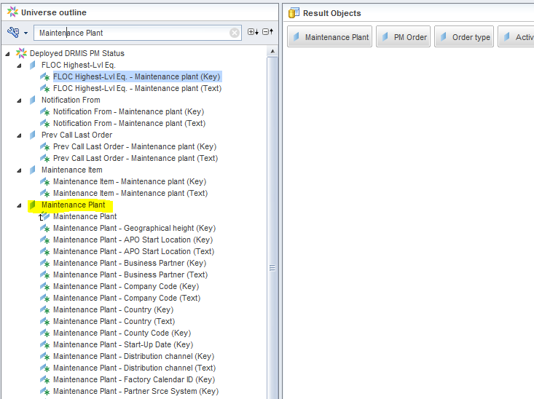
Query Panel (contd.)
Searching for an object name in Query Panel:
Ch. 5

Slide 56
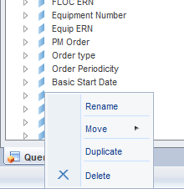
Query Panel (contd.)
Rename/Move/Duplicate/Delete a query in Query Panel:
Ch. 5

Slide 57
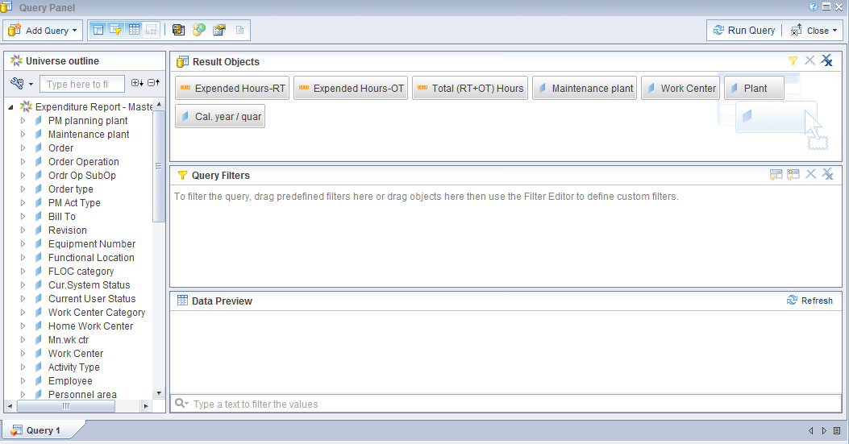
Selecting Result Objects
Within the Query Panel, select objects from the “Outline” box on the left-hand side. By double clicking on an object, it will be populated in the “Result Objects” box.
Ch. 5

Slide 58
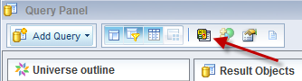
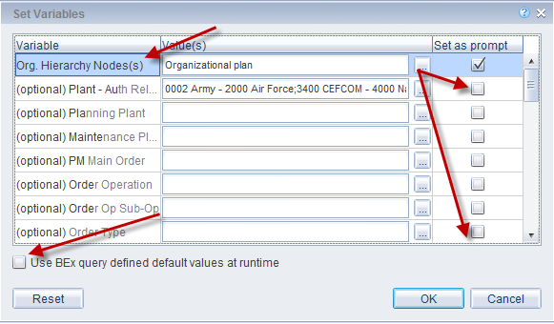
Changing Default Prompts thru Set Variables
Click on the “Set Variables” button in the top left corner to change what default prompts come up when a BEx query is being executed.
Ch. 5

Slide 59
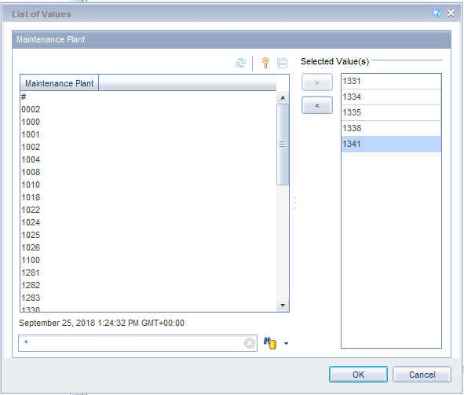
Changing Default Prompts thru Set Variables (contd.)
Searching for particular value(s) in list of values, e.g., Maintenance Plant with numbers only:
Ch. 5

Slide 60
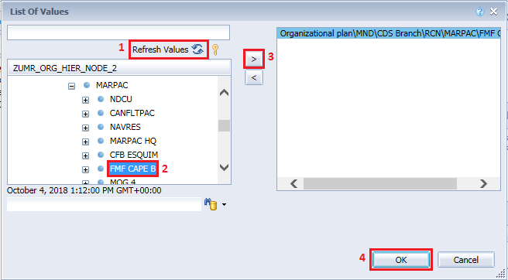
Exercise 3
Exercise 3: Create a WebI Document with a BEx Query.
Create a WebI Document using the RCN template and use a BEx query as the data source. Also, delete the Query 1 that comes with the standard template.
Note: In order to select “FMF CAPE B” for “Org. Hierarchy Nodes(s)”, click on the “Refresh Values” button and then expand the “Organizational plan” as follows: MND -> CDS Branch -> RCN -> MARPAC, and then select “FMF CAPE B”:
Ch. 5

Slide 61
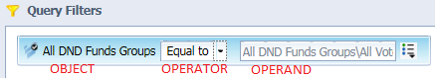
Setting Query Filters
For most types of data sources, Query Filters can be used within the Query Panel to retrieve only the data you want. Query Filters improves performance by reducing data being transferred over the network from the database to the WebI Document.
Query Filters have three parts:
Object – the report object to be filtered
Operator – relationship between the object and operand, like, equal to, greater than, etc.
Operand – the value of the object to be filtered
Ch. 5

Slide 62
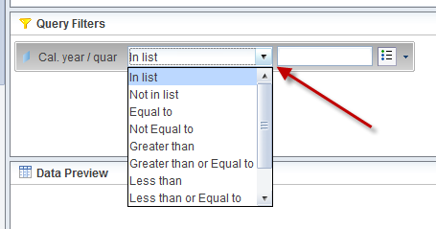
Setting Query Filters (contd.)
Types of Query Filters
Single value filters
Multi value filters
Filters with Prompts
Complex filter with nested with And and Or
List of Operators
Creating a “In List” Filter
Ch. 5

Slide 63
Exercise 4
Exercise 4: Add Query Filters to the WebI Document.
Add a filter to an existing WebI document at the query level. Query filters can be used to reduce the time it takes for a BEx query to run, as well as filtering out irrelevant data.
Ch. 5

Slide 64
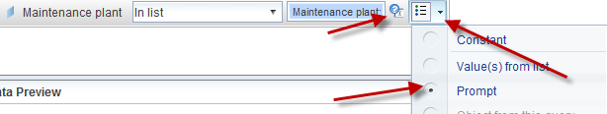
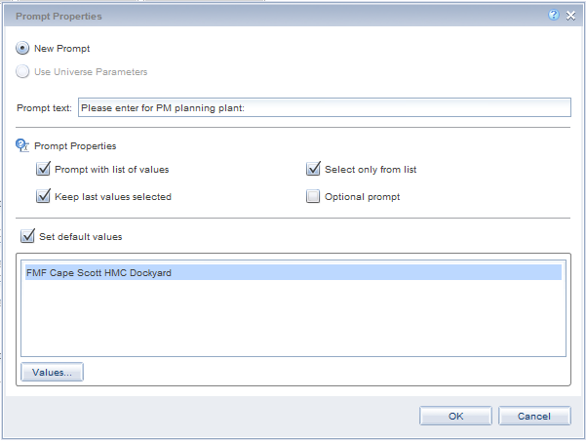
Setting Query Filters (contd.)
Filters with Prompts
Prompt Properties
Prompt with list of values
Select only from list
Keep last values selected
Optional prompt
Ch. 5

Slide 65
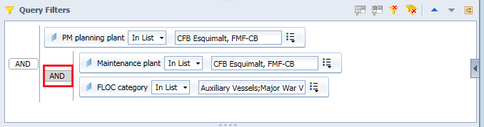
Setting Query Filters (contd.)
Complex Filters: when there are more than one filter in the Query Filters using the AND operator.
Note: OR operator does not work on BEx Queries.
Ch. 5

Slide 66
Exercise 5
Exercise 5: Adding Filters with prompts to the WebI Document.
The intent of this exercise is to create query filter with prompt. This is an essential skill for an author when creating interactive WebI reports.
Ch. 5

Slide 67
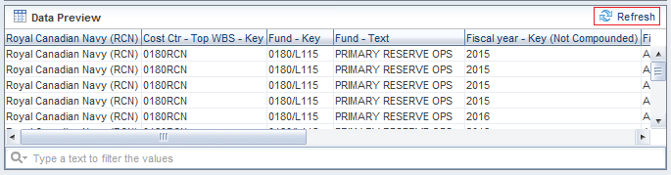
Data Preview
Once the Result Objects are selected and Query Filters are added, you can click on the “Refresh” button in the “Data Preview” Panel to see what set of data you will be getting from the query.
Ch. 5

Slide 68
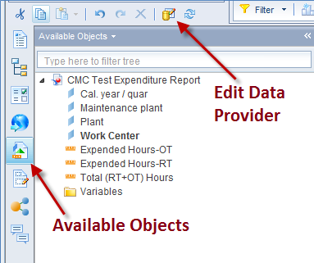
Edit Data Provider (Query)
Once a query is run, WebI will bring you to the Report Panel. All of the objects you selected will appear in the “Available Objects” tab on the left-hand menu.
To add, remove, or change an object from the query, you can click on the “Edit Data Provider” button. This will bring you back to the Query Panel screen.
Ch. 5

Slide 69
Chapter 6 – Report Panel
6.1. Types of Tables
6.2. Adding a Table to the Report
6.3. Types of Charts
6.4. Adding a Chart to the Report
6.5. Formatting the Chart
6.6. Adding a Free-standing Cell to the Report
6.7. Adding a Comment to the Report

Slide 70
Types of Tables
The easiest and often most powerful way of displaying data is through tables. WebI provides few types of tables:
Vertical Table with header cells on the top
Horizontal Tables with header cells on the row (which are particularly helpful for financial and balance sheet reports)
Cross Tables that show data in a matrix of column and row headers
Form which are useful to display detailed information by certain dimension (like, customer or product)
Ch. 6

Slide 71
Adding a Table to the Report
Create a table by selecting objects from Available Objects panel
Create a blank table and then dropping the objects
Various formatting options for the table:
Table Name
Show Table Header and Footer
Hide Always / when Empty / Formula
Border
Layout -> Relative Position
Ch. 6

Slide 72
Exercise 6
Exercise 6: Create a WebI Document with a table.
The intent of this exercise is to create a table in your WebI document. Tables are a necessary first step in visualizing data. Once a table is created, it can be used to create other visualization objects (Exercise 7).
Ch. 6

Slide 73
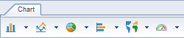
Types of Charts
WebI offers various different types of charts to graphically display your business information.
Bar Charts
Column Charts
Gauge
Geographic
Line Charts
Map
Pie Charts
Point Charts
Tile
Waterfall Chart
Tag Cloud Chart
Radar Chart
Box Plot Chart
Ch. 6

Slide 74
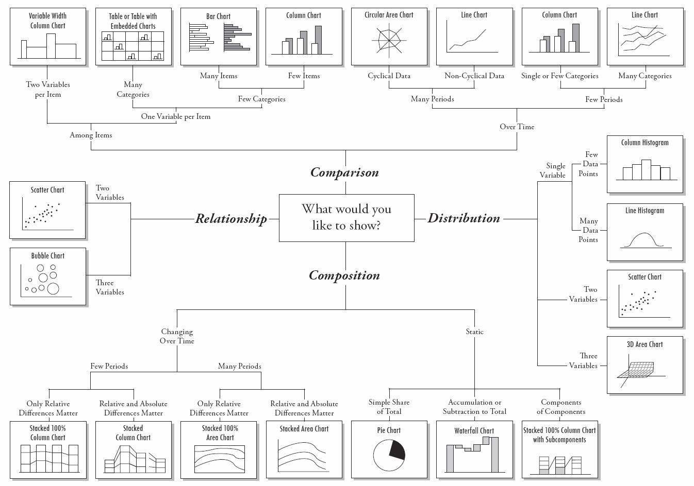
Choosing the right type of Chart
Ch. 6

Slide 75
Adding a Chart to the Report
Create a chart by creating a table from Available Objects first
Create a blank chart and then dropping the objects
Various formatting options for the chart:
Chart Title, Category Axis Title, Value Axis Title
Show Table Header and Footer
Hide Always / when Empty / Formula
Border
Layout -> Relative Position
Ch. 6

Slide 76
Exercise 7
Exercise 7: Create a Web Intelligence Document with Chart.
The intent of this exercise is to create a chart in your WebI document as well as modify the chart’s settings. Charts are used to visually show variation between various data points which is a useful tool in quickly reviewing information.
Ch. 6

Slide 77
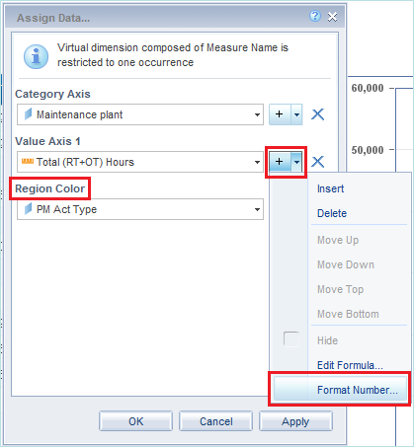
Miscellaneous Chart Options
Assign Data -> Regional Color
Assign Data -> Format Number
Ch. 6

Slide 78
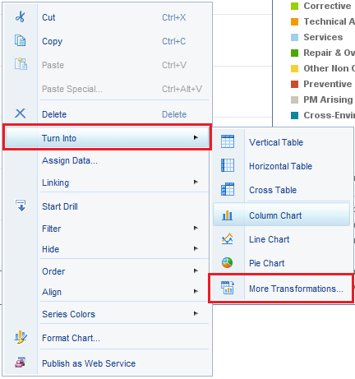
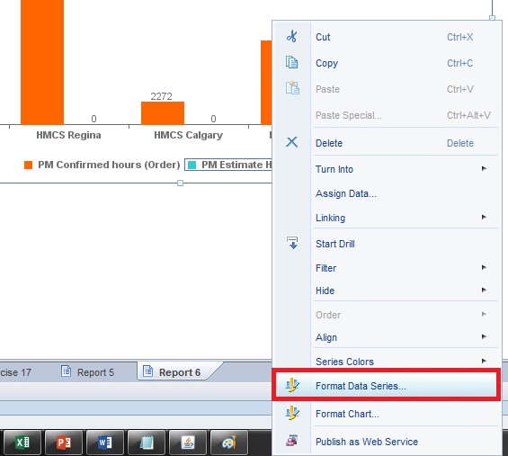
Miscellaneous Chart Options (contd.)
Turn into -> More Transformations
Format Data Series -> Series Color
Series settings over Chart Settings
Ch. 6

Slide 79
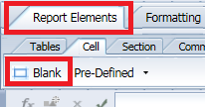




Adding a Free-standing Cell to the Report
Adding a Text content
Adding an image content
http://collaboration-navy.forces.mil.ca/ent/casc/SiteAssets/CrestsLogos/Ships/calgary.jpg
Ch. 6

Slide 80

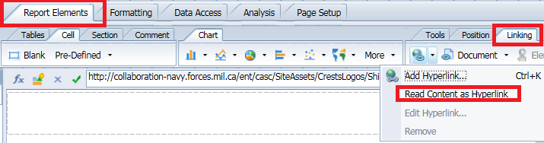

Adding a Free-standing Cell to the Report (contd.)
Adding a Hyperlink
http://collaboration-navy.forces.mil.ca/ent/casc/SiteAssets/CrestsLogos/Ships/calgary.jpg
Ch. 6

Slide 81
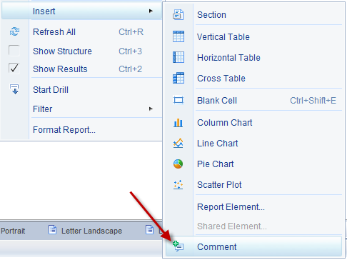
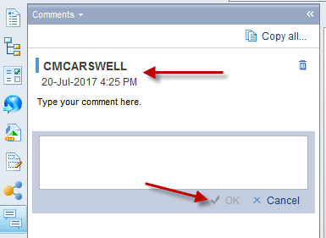
Adding a Comment to the Report
A Comment Section can be added to a report to allow Consumers and the Author to make comments on a report.
Ch. 6

Slide 82
Chapter 7 – WebI Data Calculation
7.1. Calculations
7.2. Formula Editor
7.3. Variable Editor

Slide 83
Calculations
Calculations can be added to sum up or count a group of cells. Calculations are best added in conjunction with breaks to appropriately sum or count data.
Select the column that you wish to add a calculation to and then click on the desired function from the “Functions” sub-tab under “Analysis” tab.
Sum
Count
Average
Min
Max
Percentage
Ch. 7

Slide 84
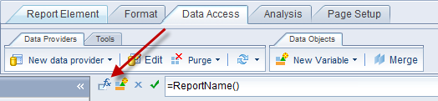
Formula Editor
Formula Editor is used to create formulas to manipulate data in a report.
Ch. 7

Slide 85
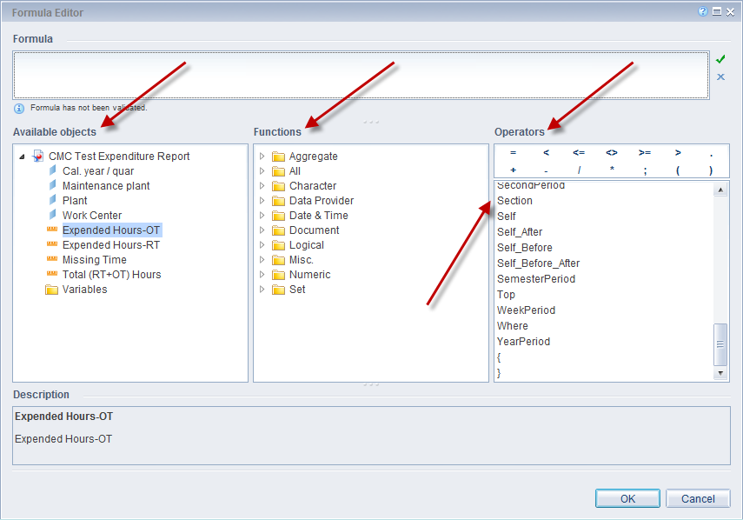
Formula Editor (contd.)
The Formula Editor box provides all available objects, functions, operators and values to create individualized formulas.
Ch. 7

Slide 86
Exercise 8
Exercise 8: Creating Calculations and Formulas.
The intent of this exercise is to show how to perform calculations on tables and how to use formulas to perform next level data aggregation.
Note: In order to select “FMF CAPE B” for “Org. Hierarchy Nodes(s)”, click on the “Refresh Values” button and then expand the “Organizational plan” as follows: MND -> CDS Branch -> RCN -> MARPAC, and then select “FMF CAPE B”:
Ch. 7

Slide 87
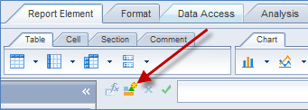
Variable Editor
Variable Editor is used to create Variables. Variables are similar to formulas, but these objects can be used in multiple tables/charts in a document.
Ch. 7

Slide 88
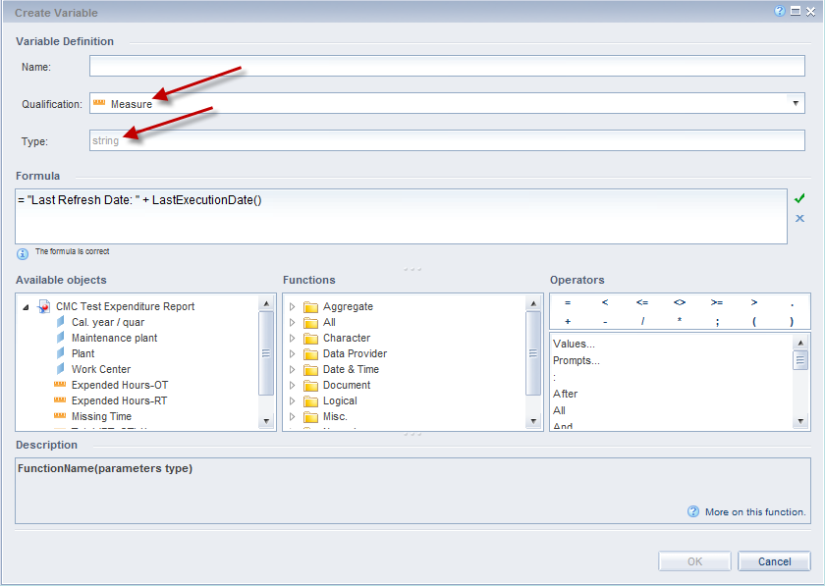
Variable Editor (contd.)
You need to provide a name for the variable, set the right qualification, write the formula and then validate the formula while in this editor.
Ch. 7

Slide 89
Exercise 9
Exercise 9: Creating Variables.
The intent of this exercise is to change an existing function into a variable. Variables can be used throughout the WebI Document, and you can copy them into other documents when needed.
Ch. 7

Slide 90
Chapter 8 – WebI Functions
8.1. Functions
8.2. Character Functions
8.3. Date Functions
8.4. Logical Functions
8.5. If Logic

Slide 91
Functions
In WebI formulas and variables use various functions and logics to achieve greater manipulation and presentation of data.
These functions can be applied to a dimension or a measure either directly or inside a variable to achieve certain formatting or logical outcome.
You can access these functions either in the “Formula Editor” or the “Create Variable” window.
Ch. 8

Slide 92
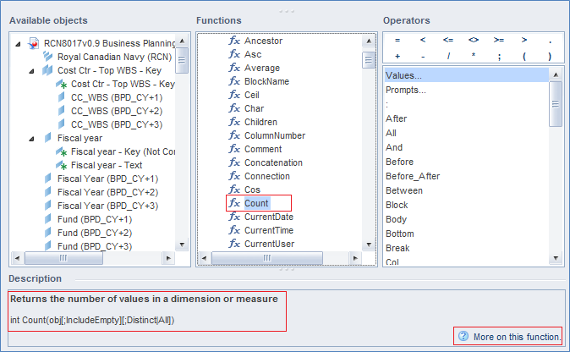
Functions (contd.)
These functions are grouped by category, like, Character, Data Provider, Date & Time, Numeric, etc. Or, you may check all the functions at once under the group called “All.”
Ch. 8

Slide 93
Character Functions
Some of the most popular character functions that are used to manipulate a string object:
Length() – return the length of string.
Pos() – returns the position of a character within a string.
Right() – returns specified number of character from the right.
Left() – returns specified number of character from the left.
Replace() – replaces a specific string with another one.
SubStr() – returns specified string from a string using starting position and length.
Ch. 8

Slide 94
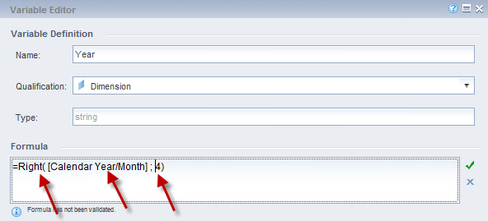
Character Functions (contd.)
The Right() Function is used to show a limited number of text within a dimension object as defined in the formula.
Enter the dimension you want from the available objects box within the parenthesis of the function.
Enter the number of characters you want removed in a numerical value (ex: 4) after the semicolon (;).
Ch. 8

Slide 95
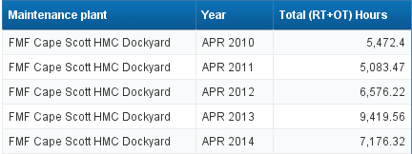
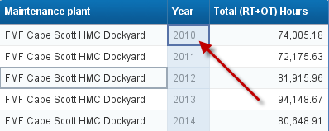
Character Functions (contd.)
Year before and after using the formula:
Before:
After:
Ch. 8

Slide 96
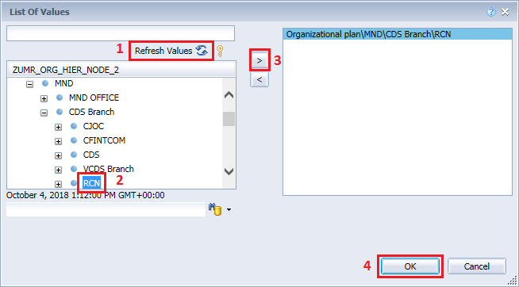
Exercise 10
Exercise 10: Creating a Right() or Left() Variable.
The intent of this exercise is to create other variables than what was created in exercise 9. There are many variables and you are encouraged to create more past this exercise.
Note: In order to select “RCN” for “Org. Hierarchy Nodes(s)”, click on the “Refresh Values” button and then expand the “Organizational plan” as follows: MND -> CDS Branch, and then select “RCN”.
Ch. 8

Slide 97
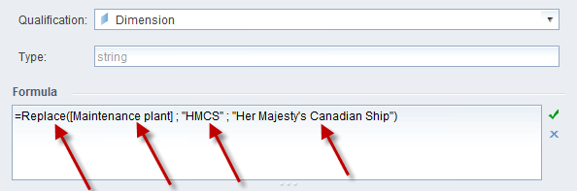
Character Functions (contd.)
The Replace() Function is used to replace a part of a string with another string.
=Replace( [dimension] ; “text” OR [dimension] ; “text” OR [dimension] )
e.g.:
=Replace( [Maintenance plant] ; "HMCS" ; "Her Majesty's Canadian Ship" )
Ch. 8

Slide 98
Exercise 11
Exercise 11: Creating a Replace() Variable.
The intent of this exercise is to create a replace variable, which is often used when turning a standard code into a text that can be readable to consumers.
Ch. 8

Slide 99
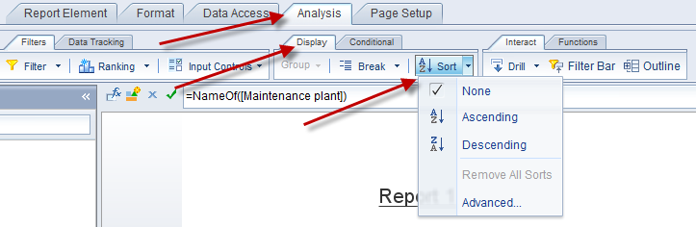
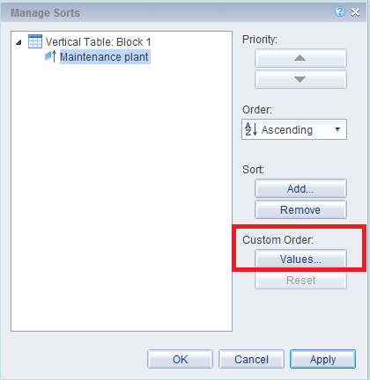
Sort
Sort lets you arrange an object either ascending or descending or in a custom order.
Ch. 8

Slide 100
Exercise 12
Exercise 12: Handling Date Object with Character Functions.
The intent of this exercise is to show how to create variables that modify date functions. Some date functions can be used for calculation, while others are used for text display.
Ch. 8

Slide 101
Date Functions
Some of the most popular date functions that are used to manipulate a date object:
ToDate() – converts a string to date type.
DaysBetween() – returns the number of days between two dates.
CurrentDate() – returns the current date formatted according to the regional settings.
CurrentTime() – returns the current time formatted according to the regional settings.
RelativeDate() – returns a date relative to another date
Ch. 8

Slide 102
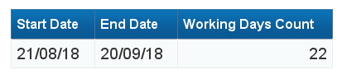
Date Functions (contd.)
Finding number of working/business days between two dates:
= Floor(DaysBetween([startdate];[enddate])/7)*5+ (Mod(DaysBetween([startdate];[enddate]);7)- If (Mod(DaysBetween([startdate];[enddate]);7)) > DayNumberOfWeek([enddate]) Then (If (Mod(DaysBetween([startdate];[enddate]);7)) - DayNumberOfWeek([enddate]) >=2 Then 2 Else (Mod(DaysBetween([startdate];[enddate]);7)) - DayNumberOfWeek([enddate]))Else If (Mod(DaysBetween([startdate];[enddate]);7))<= DayNumberOfWeek([enddate]) Then (If DayNumberOfWeek([enddate]) <=5 Then 0 Else (Mod(DaysBetween([startdate];[enddate]);7) -5)))
Ch. 8

Slide 103
Logical Functions
Some of the most popular logical functions:
IsNull() – determines whether a value is null.
IsError() – determines whether an object returns an error.
IsNumber() – determines whether a value is a number.
IsString() – determines whether a value is a string.
IsDate() – determines whether a value is a date.
Ch. 8

Slide 104
If Logic
The If logic function allows you to create dynamic variables and are the basis of boolean logic. This allows authors to display patterns within data or show trends.
If logic functions can be written in two ways:
=If ( [Order Amount (Gross)] >= 1000000 )
Then "High Expenditure"
Else "Low Expenditure"
=If ( [Order Amount (Gross)] >= 1000000 ; "High Expenditure" ; "Low Expenditure" )
Ch. 8

Slide 105
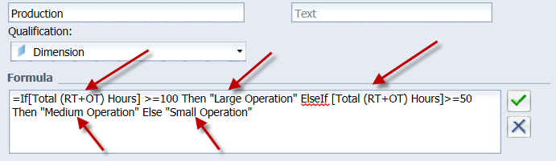
If Logic (contd.)
Other functions within this section can all be used in conjunction with If, Then, and Else function.
=If ( [Total (RT+OT) Hours] >=100 ) Then "Large Operation" ElseIf( [Total (RT+OT) Hours]>=50 ) Then "Medium Operation" Else "Small Operation"
Ch. 8

Slide 106
Exercise 13
Exercise 13: Creating an If, Then, and Else Function.
The intent of this exercise is to add functionality to variables by using IF statements. This expands your current functionality and is used in many WebI Documents.
Ch. 8

Slide 107
Chapter 9 – Multiple Datasources
9.1. WebI Report with Multiple Queries
9.2. Merge Data from multiple Data Provider

Slide 108
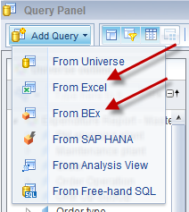

WebI Report with Multiple Queries
WebI can pull from many different Data Sources to create reports. This needs to be done to augment a report or to add important elements of data.
The source of these Data Providers can be combination of BEx Queries, Universes and/or Excel SpreadSheets.
Ch. 9

Slide 109
Exercise 14
Exercise 14: Creating Reports with two BEx Queries.
The intent of this exercise is showing how to combine and use multiple BEx queries in one WebI Document. Many reports have multiple data sources which range from Excel, BEx as well as Universes.
Ch. 9

Slide 110

Merge Data from multiple Data Provider
One can merge data from two or more Data Providers to be able to analyze them as one object.
Ch. 9

Slide 111



Merge Data from multiple Data Provider (contd.)
Objects can be merged in two ways.
Ch. 9

Slide 112
Merge Data from multiple Data Provider (contd.)
Merging Rules:
Only dimensions and attributes can be merged.
Same Data Type: Objects must have the same data type. You cannot merge a number with a string, even if the values match.
As many queries and dimensions as you need: Any number of queries and dimensions can be merged. There is no limit. But they report will be harder to maintain.
Pay attention to values: Values are case-sensitive. If the values are the same, but of different case, they will not match. They will be shown as different values. Watch out for trailing blanks. Even if the values look exactly the same, they won’t match if one has a trailing blank, and the other one doesn’t.
BEx Query and Excel SpreadSheet data can be merged together as long as object type and data type are same.
Ch. 9

Slide 113
Exercise 15
Exercise 15: Merging Dimension and Measure Objects in a report.
The intent of this exercise is to continue from exercise 14 with the two BEx queries and merge dimensions. This merging will be done with two BEx, but the same principles apply when merging Excel, BEx, Universes or all three.
Ch. 9

Slide 114
Exercise 16
Exercise 16: Adding Dimension Objects to existing Merged Objects in a report.
The intent of this exercise is to create new variables that are based on merged objects. This is often used to determine sums or calculations from two different data sources.
Ch. 9

Slide 115
Chapter 10 – WebI Data Presentation
10.1. Break
10.2. Section
10.3. Filter
10.4. Input Control
10.5. Conditional Formatting Rule
10.6. Ranking
10.7. Element Linking

Slide 116


Break
Break can be created within a table to add divisions within the data for calculation and presentation purposes. A break separates the table based on the column that you choose. All similar data is placed within the same break.
Ch. 10

Slide 117


Break (contd.)
Example of a Break:
Breaks’ settings under Manage Breaks:
Ch. 10

Slide 118
Exercise 17
Exercise 17: Creating Breaks and Using Sort.
The intent of this exercise is to display table data in various methods using visual breaks by a sorted object. This is used to display long lists of data and often has a running sum for each of the sections.
Ch. 10

Slide 119


Section
Similar to Breaks, sections can be created to visualize a division between different points of data.
By creating nested sections using different objects either from an Excel SpreadSheet based query or a BEx query one can create pseudo hierarchy.
Use the “Report Map” tab from the left-hand menu to navigate thru the pseudo hierarchy(s).
Ch. 10

Slide 120

Section (contd.)
Example of two nested sections using Calendar Year/Quarter and Maintenance Plan objects:
Ch. 10

Slide 121

Section (contd.)
Report Map shows the nested sections one under another like a hierarchy:
Ch. 10

Slide 122
Exercise 18
Exercise 18: Creating Sections.
The intent of this exercise is to create a section for a table and display the sum for each section. Sections have a similarity to breaks but have a different visualization.
Ch. 10

Slide 123


Filter
Filter can be added to a table, chart, report and/or section to limit data that are being displayed in the report. Filters can only be added or removed in the design mode, not in viewing mode.
Ch. 10

Slide 124

Filter (contd.)
Components of a Report Filter:
Ch. 10

Slide 125
Exercise 19
Exercise 19: Using Filters.
The intent of this exercise is to set filters in your WebI Reports at design time.
Ch. 10

Slide 126


Input Control
Input Control can provide an additional way to limit the data that is displayed in reports. Input Control can be changed by a consumer of a report, and allows them to select the data that they wish to view.
Ch. 10

Slide 127


Input Control (contd.)
Steps to create an Input Control:
Ch. 10

Slide 128

Input Control (contd.)
A sample Input Control with “OK” button:
Ch. 10

Slide 129
Exercise 20
Exercise 20: Creating Input Controls.
The intent of this exercise is to create an input control that allows consumers to change the view of a WebI Document. This is a very essential skill to have when creating interactive documents.
Ch. 10

Slide 130


Conditional Formatting Rule
Conditional Formatting rules can assist reports in highlighting crucial data. They can be applied to tables, individual cells, and within sections and breaks.
When using Conditional Formatting, the rule can apply to a different cell than the cell that the calculation is on.
For example, you can set the text to Red font with Yellow background, if a number is larger than 10000, but that conditional format could be applied anywhere on the row, not just on the cell that has the larger than 10000 value.
Ch. 10

Slide 131


Conditional Formatting Rule (contd.)
Steps to create a Conditional Formatting Rule:
Ch. 10

Slide 132
Exercise 21
Exercise 21: Creating Formatting Rules.
The intent of this exercise is to create rules to format a table. This method has been used by many authors as a first main report to show visualizations of changes. These formatting rules can use complex formulas as well as detailed visual effects.
Ch. 10

Slide 133

Ranking
For a particular measure, you can show top and/or bottom values only. You can apply the ranking at the database level (in Query Panel) or at the report level in the report tab page.
Ch. 10

Slide 134



Ranking (contd.)
Example of ranking:
Ch. 10

Slide 135


Element Linking
If you would like to control the content of one or more tables and charts based on the selected value of a particular table/chart, you can do so by using Element Linking.
Ch. 10

Slide 136


Element Linking (contd.)
Select the report object and assign the report elements to be controlled by that object:
Ch. 10

Slide 137

Element Linking (contd.)
Menu button for the Element Linking:
Ch. 10

Slide 138

Element Linking (contd.)
Context menu of the object’s Element Linking functionality:
Ch. 10

Slide 139
Exercise 22
Exercise 22: Creating Element Linking.
The intent of this exercise is to create linked tables using Element Linking. Element linking is used to control the content of one or more tables and charts based on the selected value of a particular table/chart.
Ch. 10

Slide 140
Chapter 11 – WebI Document Formatting
11.1. Formatting Report
11.2. Formatting Table
11.3. Formatting Cell
11.4. Formatting Numbers
11.5. Formatting Header and Footer
11.6. Formatting Section
11.7. Formatting Chart

Slide 141
WebI Document Formatting
WebI document formatting options would need to be used to create reports that match with your organizations standard. The templates are being provided to take care of many of these formatting options, however you would still need to use many of these formatting techniques while designing a WebI report.
Generally from the context menu of any object (like, report body, header, footer, table, document structure, etc.) you can get to the format window for that particular object.
Context menu is the menu that you get by right-clicking on a certain object.
In the following slides the most useful formatting options under each category are being documented and most of these are already being discussed in prior chapters.
Ch. 11

Slide 142
Formatting Report
You can get various report related formatting options by right clicking on any blank area on the report body. Following are the most useful ones:
Layout
Page Size
Orientation
Page Scaling
Margins
Header and Footer size
Appearance
Color, Patter, Hyperlink Color, etc.
Border
Ch. 11

Slide 143
Formatting Table
Following are the most used formatting options for a table:
General
Name: it’s a good idea to give unique name to your table if you are dealing with multiple tables
Show Table Headers, Show Table Footers
Hide always: when you need a table but don’t want to show it
Hide when Empty
Hide when following formula is true
Border
Appearance: Color, Pattern, Spacing and Padding, Alternate Color
Layout
Horizontal - Start on a new page, Horizontal - Avoid page break
Vertical - Repeat header on every page, Vertical - Repeat footer on every page
Vertical – Avoid page break, Relative Position - Horizontal and Vertical
Ch. 11

Slide 144
Formatting Cell
Following are the most used formatting options for a cell:
General
Auto fit width
Auto fit height
Read contents as
Alignment
Horizontal alignment
Vertical alignment
Display – Wrap text
Display – Merge Cells
Font
Border
Appearance
Color
Pattern
Image from address
Image from file
Ch. 11

Slide 145

Formatting Numbers
To change how numbers appear within a table, click on the “Format” tab and the “Numbers” sub-tab. You will be able to select how you want the data to be presented by using the drop down menu to select the desired format. You can also select the Percentage sign to change the number into a percentile.
Ch. 11

Slide 146

Formatting Numbers (contd.)
Custom Formatting Numbers:
While in a numeric field, go to “Format -> Numbers” tab, click on “Custom” button and then go to the “Custom” section in the “Format Number” window, and again click on the “custom” button to get the “New Custom Format” window:
Here type in “#,#.#” and “-#,#.#” in the Positive and Negative input boxes, respectively. This will give one decimal point rounded up to the nearest 10s. This will show “1.29” as “1.3” and “1.98” as “2”
Ch. 11

Slide 147
Formatting Header and Footer
Following are the most used formatting options for header and/or footer:
Appearance
Color
Pattern
Image from address
Image from file
Layout
Show header/footer
Height
Ch. 11

Slide 148
Formatting Section
Following are the most used formatting options for header and/or footer:
General
Display – Minimum height
Hide when Empty
Hide when following formula is true
Appearance
Color
Pattern
Image from address
Image from file
Layout
Start on a new page
Repeat on every page
Avoid page break
Minimum top offset
Top Margin
Ch. 11

Slide 149
Formatting Chart
Charts have too many options to format, refer to the course booklet section 11.7 for the detailed list of those options.
Ch. 11

Slide 150
Chapter 12 – WebI Calculation Context
12.1. Default Calculation Contexts
12.2. User Defined Calculation Contexts
12.3. Contexts Operators

Slide 151
WebI Calculation Context
The value/amount returned by a measure (in a calculation) depends on the dimensions it is associated with in the immediate block and this combination of dimensions is called Calculation Context.
Calculation Context, either default or user defined, is the way to control the behavior of any calculation on a measure.
Ch. 12

Slide 152


Default Calculation Context
Depending on the placement of a measure in a report or in a table or in a chart, a measure or a calculation on a measure would return a certain result. This is known as Default Calculation Context.
Example: in the following table the Actual measure is aggregated up to the RCN Cost Center and shown as a single value:
However, if Fiscal Year is added in the table, the Actual amount would be broken out by both Cost Center and Fiscal Year dimensions:
Ch. 12

Slide 153
User Defined Calculation Context
Calculation context of any calculation or formula in WebI can be reclassified by defining either or both of its input and output contexts.
Input Context is used to determine what values are taken into the calculation. For example, “User is required to take into the calculation, one number for every Fiscal Year.”
Output Context is used determine the level or dimension, by which the calculation is output. For example, “User is required to use a formula to display (/output) one number for every Fiscal Year.”
Ch. 12

Slide 154

Input Context
Input context is the set of dimensions that are used to make the calculation. These dimensions in the input context appear inside the parentheses of the function whose input context is being specified.
Example: You need a report showing fiscal year, posting period, actuals per year/period, and the actual percentage within that year.
In order to compute the yearly actual percentage, you would need to get the yearly actual total by using the following Input Context formula:
=Sum( [Actual] IN ( [Fiscal Year] ) )
Ch. 12

Slide 155
Output Context
The output context consists of set of dimensions that determine where the calculation would be placed in the report, i.e., the level where the calculation is to be performed.
The output context appears after the parentheses of the function.
It causes the formula to output a value as if it is placed in the footer of a block containing a break.
Ch. 12

Slide 156

Output Context (contd.)
Example: You need a report showing fiscal year, posting period, actuals per year/period, the maximum actual within that year, and then the difference between that period’s actual to the maximum for that year actual.
The maximum actual within that year can be calculated by using an Output Context formula:
=Max( [Actual] ) IN ( [Fiscal Year] )
Ch. 12

Slide 157

Contexts Operators - IN
IN context operator is used to specify exactly which dimensions to be included in the calculation. Other dimensions in the block are ignored.
Adding/removing other dimensions from the block does not affect the calculation because certain dimensions are already specified as part of the context.
Example: You need a report showing fiscal year, total yearly actual and the maximum actual within that year in a posting period.
Ch. 12

Slide 158

Contexts Operators – IN (contd.)
Solution: Create a table with Fiscal Year and Actual. But if you add a column to show the Max([Actual]), the result would be same as yearly Actual value.
You can use the IN context operator as input context on Fiscal Year and Posting Period dimensions to achieve the maximum actual within that year in a posting period:
=Max( [Actual] IN ( [Fiscal year] ; [Posting period] ) )
Ch. 12

Slide 159

Contexts Operators – IN (contd.)
Other dimensions in the block are ignored, e.g. even with the Commitment Item dimension in the table the following formula is still giving the max Actual by fiscal year and posting period:
=Max( [Actual] IN ( [Fiscal year] ; [Posting period] ) )
Ch. 12

Slide 160

Contexts Operators – IN (contd.)
With Commitment Item in the formula you would not get the correct value since it will then try to find maximum based on fiscal year, posting period and commitment item altogether:
=Max( [Actual] In ( [Fiscal year] ; [Posting period] ; [Cmmt Item] ) )
Ch. 12

Slide 161

Contexts Operators – IN (contd.)
This is how the table would look like for Fiscal year 2017 and commitment item and posting period in it:
Ch. 12

Slide 162

ForEach Context Operator
ForEach context operator is used to add more dimension(s) in a context that affects the calculation along with all other dimensions in the block.
Example: You need a report showing fiscal year, total yearly actual and the maximum actual within that year in a posting period.
Ch. 12

Slide 163

ForEach Context Operator (contd.)
Solution: Create a table with Fiscal Year and Actual. But if you add a column to show the Max([Actual]), the result would be same as yearly Actual value.
You can use the ForEach context operator as input context on Posting Period dimension and it will augment the Fiscal Year dimension that is already there in the table/block:
=Max( [Actual] ForEach ( [Posting period] ) )
Ch. 12

Slide 164

ForEach Context Operator (contd.)
The same can be achieved using the IN operator. You would need to mention both fiscal year and posting period dimensions in the IN formula but in the foreach formula you just need to mention the posting period as fiscal year already exists in the table:
=Max( [Actual] ForEach ( [Posting period] ) )
=Max( [Actual] IN ( [Fiscal year] ; [Posting period] ) )
Ch. 12

Slide 165

ForAll Context Operator
ForAll context operator is used to exclude a dimension from context. Other dimensions of the block will still be considered.
Adding or removing dimensions from the block will change the value, but it will always ignore the ForAll dimension(s).
Example: You need a report showing fiscal year, posting period, actuals per period and total yearly actual.
Ch. 12

Slide 166

ForAll Context Operator (contd.)
Solution: Create a table with Fiscal Year, Posting Period and Actual. You can then use the ForAll context operator to exclude the Posting Period from your summing function and thus you can get the total of the actual per year:
=Sum( [Actual] ) ForAll ( [Posting period] )
You can achieve the same result by using IN context operator on the Fiscal Year ignoring the posting period altogether:
=Sum( [Actual] ) IN ( [Fiscal year] )
Ch. 12

Slide 167

Report Structures – In Report, In Block, In Section, In Body, In Break
In Report: sets the context at the overall report level. Any formula with this keyword will return overall total. Total may still be affected by report filters.
In Block: sets the context at each block. In a report with sections, the “In Block” would yield different value than the “In Report.”
=Max( [Actual] ) In Block
In Section: sets the context at a section only.
In Body: it is a standard context for each row of data.
In Break: sets the context at the break level.
Ch. 12

Slide 168

Where Operator
The Where operator restricts the data to be used in a calculation.
Example: You need a report showing fiscal year, posting period, actuals per period and sum of all actuals for periods greater than one.
Solution: Create a table with Fiscal Year, Posting Period and Actual. You can then use Sum function on Actual along with the WHERE operator to sum all periods that are greater than one:
=Sum( [Actual] ) Where ( ToNumber( [Posting period] ) > 1 )
Ch. 12

Slide 169


Where Operator (contd.)
The difference in outcome using Where and IF statement:
=If( ToNumber([Posting period]) > 1 ) Then Sum( [Actual] )
=Sum( [Actual] ) Where ( ToNumber( [Posting period] ) > 1 )
Ch. 12

Slide 170
Exercise 23
Exercise 23: Creating Calculation Contexts.
The intent of this exercise is to create Context Calculations. Using Calculation Contexts user can define/control the behavior of any calculation on a measure or a set of measures.
Create a report showing following scenarios:
A table showing Fiscal Year, Posting Period, Actuals per year/period, and the Actual percentage within that year.
A table showing Fiscal Year, Posting Period, Actuals per year/period, maximum Actual within that year, and then the difference between that period’s Actual to the maximum for that year Actual.
A table showing Fiscal Year, total yearly Actual and the maximum Actual within that year in a Posting Period.
A table showing Fiscal Year, Posting Period, Actuals per period and total yearly Actual.
Ch. 12

Slide 171
Chapter 13 – WebI Drilling Functionality using Hierarchy
13.1. Drilling in a Chart
13.2. Drill in a Table

Slide 172

Drilling in a Chart
As a WebI Report Author you can create a report that your consumer can drill in into a chart or table to get further details. You can provide this drilling capabilities using hierarchy objects from BEx queries.
Ch. 13

Slide 173

Drilling in a Chart (contd.)
You can right-click on the hierarchy object within the chart and from the context menu go to “Hierarchical Navigation -> Drill Focus”, and then click on either “Drill Down” or “Drill up”.
Ch. 13

Slide 174

Drilling in a Chart (contd.)
From the context menu of the hierarchy object within the chart go to “Hierarchical Navigation -> All -> Collapse All Hierarchies” to go back to the top level of the hierarchy.
Ch. 13

Slide 175

Drilling in a Chart (contd.)
It is also important to set the Default Level of Expansion so that whenever the report is being refreshed the charts are at the appropriate level to show the content. Navigate to the context menu of the hierarchy object in the chart and then go to “Hierarchical Navigation -> Default level expansion”, and choose the desired level.
Ch. 13

Slide 176
Exercise 24
Exercise 24: Creating Chart with Hierarchy Object.
The intent of this exercise is to create a Chart with Hierarchy object. Using the hierarchy object users can drill up or down into the chart.
NOTE: Steps 1-9 in Exercise 23 need to be completed before continuing this exercise
Ch. 13

Slide 177

Drill in a Table
Similarly you can create a vertical table with a hierarchy object, like, Cost Centre hierarchy, along with Fiscal Year and one or two measures, like, Actual, Allocation, etc.
Once the table is created, you would be able to click plus sign (“+”) beside the hierarchy object to drill down in to the hierarchy. The values of the measures would change automatically as per the level of the hierarchy.
Ch. 13

Slide 178
Exercise 25
Exercise 25: Creating Table with Hierarchy Object.
The intent of this exercise is to create a table with Hierarchy object. Using the hierarchy object users can drill up or down into the table.
NOTE: Steps 1-9 in Exercise 23 need to be completed before continuing this exercise.
Ch. 13

Slide 179
Chapter 14 – Additional Features
14.1. Hyperlinking
14.2. Scheduling and Instances
14.3. Exporting Data
14.4. Data Tracking
14.5. Reference Functions
14.6. User Prompts
14.7. Moving Content between WebI Documents
14.8. Visualization Techniques

Slide 180

Hyperlinking
Creating a HyperLink to an external site from WebI (better works in HTML mode)
Creating a HyperLink to a WebI document
Example:
http://md8ci.forces.mil.ca:57500/BOE/OpenDocument/opendoc/openDocument.jsp?sIDType=CUID&iDocID=M1faso8ADbisAIwAlgAALzkBAgrX98YAAAA
Note: If you make changes to the WebI document and save it as a new document, the document link (/CUID) changes, and the above link would no longer work.
http://md8ci.forces.mil.ca:57500
Ch. 14

Slide 181


Scheduling and Instances
Reports can be run routinely through scheduling.
Ch. 14

Slide 182

Exporting Data
WebI allows you to export data into Excel SpreadSheets.
This can be useful to print or distribute reports to individuals who do not have access to WebI.
There are two different processes for exporting your document depending on your WebI View preferences: Applet, HTML, or PDF.
The View preference can be changed following the process in section “Setting WebI preferences.”
Ch. 14

Slide 183


Data Tracking
When a report is updated, the difference in data points can be tracked to see progressions and differences.
Ch. 14

Slide 184

Data Tracking (contd.)
WebI displays differences in data from a preset refresh and the latest refresh. You are able to choose from a selection of refreshes that you have done in that report previously.
Ch. 14

Slide 185

Data Tracking (contd.)
You can change the formatting for dimension, detail and measure objects based on whether any value is being inserted or deleted or changed.
Ch. 14

Slide 186

Reference Functions
Variables with Reference Functions can be created to show the previous data for a dimension and the difference between the current and previous data sets.
Ch. 14

Slide 187

Reference Functions (contd.)
Example: the below table displays work orders for FMF CB for April 2017 and shows the difference between the current data and the last update. Any changes with increased values will appear in a green cell.
Ch. 14

Slide 188

User Prompts
It is a good practice to populate the User Prompts quick reference (featured by template). This is useful for Consumers who cannot edit/verify Data Source filters/prompts. Use the UserResponse() function to verify/capture Data Source prompts.
Ch. 14

Slide 189


Moving Content between WebI Documents
When moving content from inside a single Web Intelligence Document, you can right click on the object, select copy and paste it to another report tab.
Ensure that your Preferences are set to Applet for View and Modify.
Ensure that the check box “Resuse copied elements in other Web Intelligence documents (slower)” is selected.
Ch. 14

Slide 190

Visualization Techniques
There is a separate course available for Visualization Techniques, however few key factors of better visualization are:
Less is more
No excessive whitespace
Stay within canvas boundaries
Easy interpretation
Do not overload the user with unnecessary information
Ch. 14

Slide 191
Summary
In this course you have learned how to use SAP BusinessObjects Web Intelligence to create analytical and ad-hoc reports for yourself and your department.
You can now create reports consuming data from DRMIS and from external sources using Excel files. Your reports can not only contain charts, tables and graphs but you can also incorporate filters, input controls, breaks, sections and sorting to make them more robust and user friendly.
You have also received exposure as to how to navigate in and around the BI Launch Pad and its new folder structure for your reports and for other departments’ reports as well.
We hope you have enjoyed this training and we look forward to your feedback!
Ch. 15

Slide 192
Exercise 26
Exercise 26: Create your own Web Intelligence Document.
The intent of this exercise is to show how you can create a WID from an existing excel spreadsheet, include visualizations and input controls. After the exercise is complete, email your teacher a PDF of your output.
Ch. 15

Slide 193
Thank You!

